Slide 1
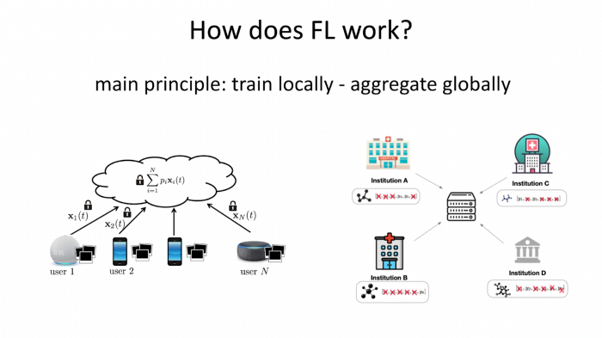
FedML
FedML Product Overview, https://medium.com/@FedML/fedml-ai-platform-releases-the-worlds-federated-learning-open-platform-on-public-cloud-with-an-8024e68a70b6

Slide 2
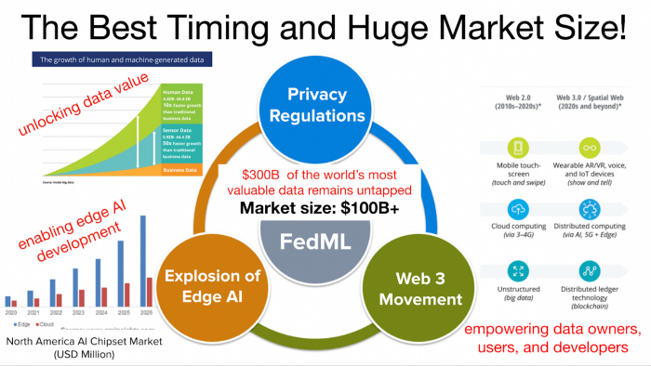
FedML
FedML Product Overview, https://medium.com/@FedML/fedml-ai-platform-releases-the-worlds-federated-learning-open-platform-on-public-cloud-with-an-8024e68a70b6
In this era, federated learning technology is critical because it is at the historical intersection of the three major technological hotspots: privacy computing, edge AI, and Web3/Blockchain.

Slide 3
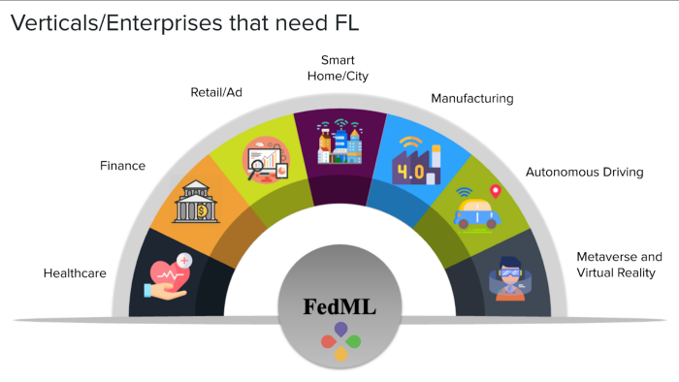
FedML
FedML Product Overview, https://medium.com/@FedML/fedml-ai-platform-releases-the-worlds-federated-learning-open-platform-on-public-cloud-with-an-8024e68a70b6
What never before have we considered is distributed AI algorithms on a large number of nodes with scattered small data while simultaneously taking into account security, system efficiency, and model accuracy.
In addition, many concepts in blockchain, including data decentralization computing, ownership verification, traceability, incentive mechanism, and trusted security, all coincide with the idea of ​​federated learning to make the data value flow safely.

Slide 4
FedML
FedML Product Overview, https://medium.com/@FedML/fedml-ai-platform-releases-the-worlds-federated-learning-open-platform-on-public-cloud-with-an-8024e68a70b6
In academia, the most popular open-source framework is undoubtedly FedML (https://github.com/FedML-AI), which is widely used around the world (see https://fedml.ai/use-cases/). (there are also some other frameworks, but FedML is the one cited most: FedML-196; Flower-96; PySyft-32; FedScale-20; FATE-14).
Today, the FedML team has further upgraded these academic achievements into an industrialized platform. Its mission is to build open and collaborative AI anywhere at any scale. In other words, FedML supports both federated learning for data silos and distributed training for acceleration with MLOps and Open Source support, covering cutting-edge academia research and industrial grade use cases.
Different from the closed-source commercial platforms of most companies or the restricted mode of “applying for a trial,” FedML focuses on building a public MLOps (ML Operations) platform, which is open to global users for free.

Slide 5
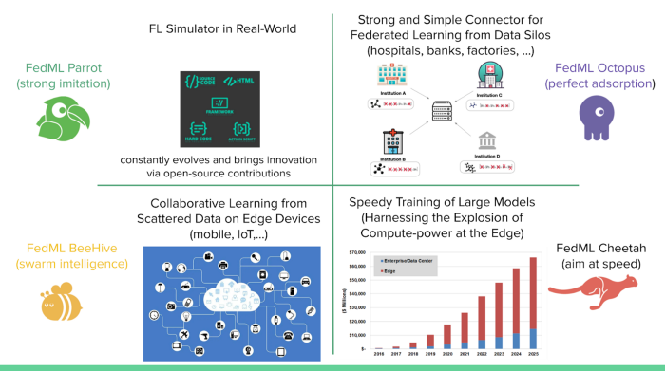
FedML
FedML Product Overview, https://medium.com/@FedML/fedml-ai-platform-releases-the-worlds-federated-learning-open-platform-on-public-cloud-with-an-8024e68a70b6
At its current stages, FedML provides the following services:
FedML Parrot — Simulating federated learning in the real world.
FedML Octopus — Cross-silo Federated Learning for cross-organization/account training, including Python-based edge SDK.
FedML Beehive — Cross-device Federated Learning for Smartphones and IoTs, including edge SDK for Android/iOS and embedded Linux.
FedML MLOps: FedML’s machine learning operation pipeline for AI running anywhere at any scale.
Model Serving: providing a better user experience for edge AI.

Slide 6
FedML
FedML Product Overview, https://medium.com/@FedML/fedml-ai-platform-releases-the-worlds-federated-learning-open-platform-on-public-cloud-with-an-8024e68a70b6
FEDML MLOPS USER GUIDE, https://open.fedml.ai/octopus/userGuides/index
Write Once, Run Anywhere: Seamlessly Migrate Your Local Development to the Real-world Edge-cloud Deployment
Video Tutorial: https://www.youtube.com/embed/Xgm0XEaMlVQ
FEDERATED LEARNING ON ANDROID SMARTPHONES, https://open.fedml.ai/beehive/userGuides/index

Slide 7
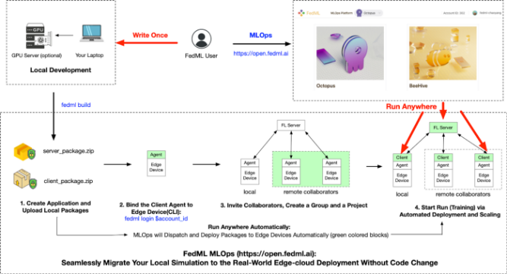
FedML
FedML Product Overview, https://medium.com/@FedML/fedml-ai-platform-releases-the-worlds-federated-learning-open-platform-on-public-cloud-with-an-8024e68a70b6
3.1 Seamless migration between simulated experiment and real deployment, zero code modification
FedML can help users seamlessly migrate the code of experimental simulation (POC) to the actual system (Production) to carry out experiments under real private data and distributed training systems of edge devices.
After it is verified that federated learning can produce modeling benefits on specific applications, users can use FedML MLOps to upgrade the simulation into production without modifying the code.
The simulated source code can be deployed directly to edge devices with real data. As shown in the upper left of Figure 1, the user first completes local development and debugging in “Local Development” and then generates installation packages.
Finally, through simple commands and UI interactions, these installation packages and scripts can be distributed to any private device (shown in red on the right of Figure 1).

Slide 8
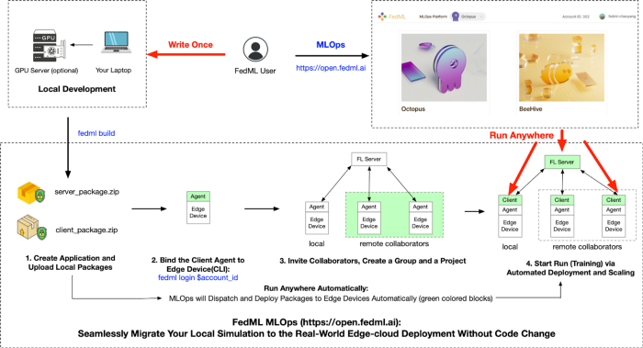
FedML
FedML Product Overview, https://medium.com/@FedML/fedml-ai-platform-releases-the-worlds-federated-learning-open-platform-on-public-cloud-with-an-8024e68a70b6
3.1 Seamless migration between simulated experiment and real deployment, zero code modification

Slide 9
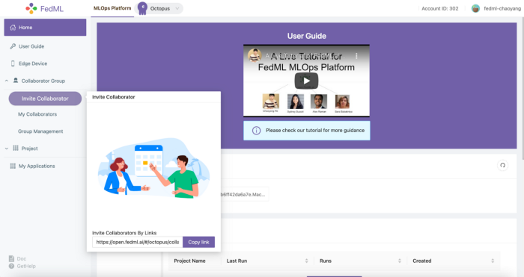
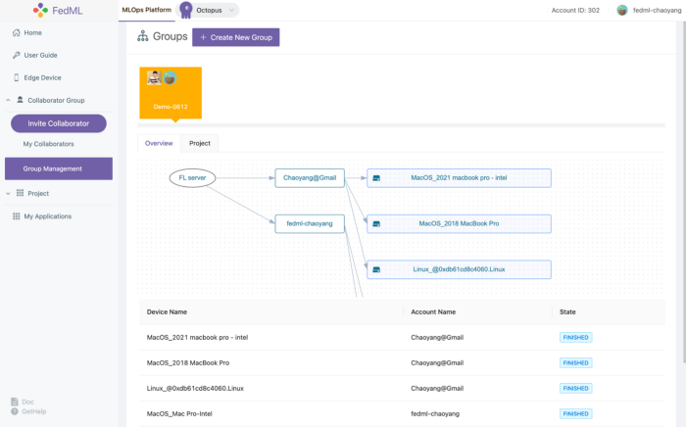
Federated Learning
FedML Product Overview, https://medium.com/@FedML/fedml-ai-platform-releases-the-worlds-federated-learning-open-platform-on-public-cloud-with-an-8024e68a70b6
3.2 One-line command to complete the edge deployment
3.3 Support simplified collaboration anywhere: multinational, cross-city, multi-tenant
FedML collaboration has become extremely simple. Just as you can collaborate on documents with friends, you can easily create a federated learning group by sending an invitation link. There are no geographical, national, or city restrictions anywhere in the world.

Slide 10
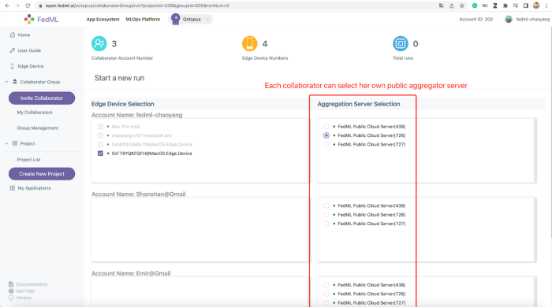
FedML
FedML Product Overview, https://medium.com/@FedML/fedml-ai-platform-releases-the-worlds-federated-learning-open-platform-on-public-cloud-with-an-8024e68a70b6
3.4 Provide free public cloud aggregation server and private cloud deployment with Docker
To reduce the difficulty of federated training, FedML’s open platform provides a public cloud aggregation server for everyone. Users can arbitrarily select free service nodes offered on the public cloud when initiating training.
FedML also considers more secure and strict deployment requirements for platform users. For this reason, FedML platform has also developed a private aggregation server library that can be deployed freely. It still only needs a one-line command, that is, the “fedml login -s” command to run a secure docker environment at any self-hosted server.

Slide 11
FedML
FedML Product Overview, https://medium.com/@FedML/fedml-ai-platform-releases-the-worlds-federated-learning-open-platform-on-public-cloud-with-an-8024e68a70b6
3.5 Experiment monitoring and analysis capabilities tailored for distributed training
In addition to the features mentioned above of lowering the user access threshold, the FedML platform also helps AI application modeling by providing experimental tracking, management, visualization, and analysis capabilities. Key capabilities currently supported include:
1. Edge device training status tracking.
2. Custom metrics reporting, such as the accuracy in common classification tasks in deep learning, the error rate of regression tasks, and even the running time of the system state, memory usage, and GPU utilization.
3. Profiling flow and edge device system performance. It can help users to view the execution performance of different subtasks on each edge device, which is convenient for analyzing the bottleneck of the system.
4. Distributed logging. This is a capability that the current general-purpose machine learning platform does not have, and it is convenient to track and analyze the anomalies that occur on each device in a real-time manner.
5. The experimental report allows users to compare multiple experimental results.

Slide 12
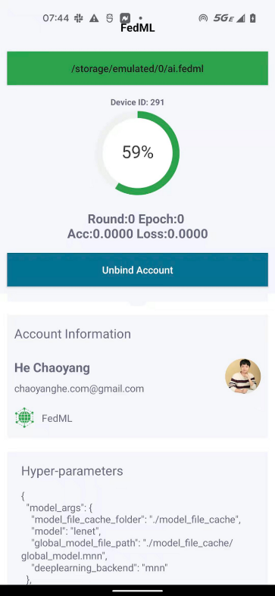
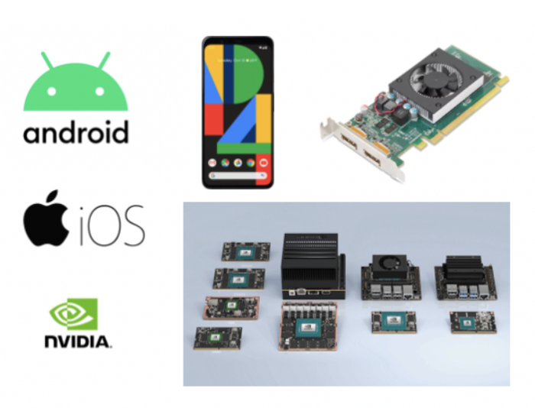
FedML
FedML Product Overview, https://medium.com/@FedML/fedml-ai-platform-releases-the-worlds-federated-learning-open-platform-on-public-cloud-with-an-8024e68a70b6
3.6 Unified cross-platform design, supporting smartphones and IoT devices
FedML also recently released the Android platform for mobile devices; details can be found at the following links:
FedML Android Platform: https://github.com/FedML-AI/FedML/tree/master/android
FedML IoT Platform: https://github.com/FedML-AI/FedML/tree/master/iot

Slide 13
FedML
FedML Product Overview, https://medium.com/@FedML/fedml-ai-platform-releases-the-worlds-federated-learning-open-platform-on-public-cloud-with-an-8024e68a70b6
4. Three-in-one Strategy for Open Collaboration: Open Source, Open Platform, Collaborative Application Ecosystem
In addition to operating open source communities, FedML promotes open collaboration and open source research and development from multiple product perspectives.
Besides the open source library (https://github.com/FedML-AI),
and open platform (https://open.fedml.ai),
FedML has also developed the collaborative App Ecosystem (users can visit https://open.fedml.ai and find “App Ecosystem” on the left top).
The App Ecosystem and the platform cooperate with each other to continuously enrich the application ecosystem. The first version has completed the open collaboration of over 20 applications.
Users can contribute and share the application. Each application includes all the FedML-based source code of an AI application, including model definitions, training scripts, and configuration files.
At present, the App Ecosystem covers mainstream AI application scenarios such as computer vision, natural language processing, graph data mining, and the Internet of Things.

Slide 14
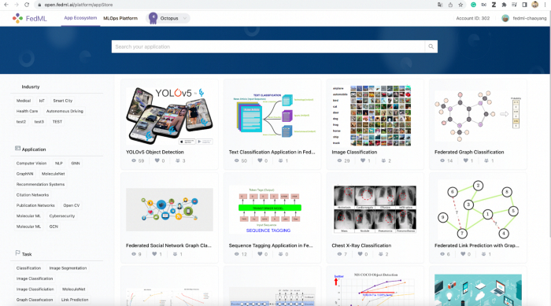
FedML
FedML Product Overview, https://medium.com/@FedML/fedml-ai-platform-releases-the-worlds-federated-learning-open-platform-on-public-cloud-with-an-8024e68a70b6
4. Three-in-one Strategy for Open Collaboration: Open Source, Open Platform, Collaborative Application Ecosystem
If the open platform reduces the difficulty of actual building deployment of the federated learning system to the lowest level, then the App Ecosystem is used to lower the AI ​​application R&D threshold for practitioners: A company needs not to hire high-cost machine learning teams but rather needs only one engineer who can do “one-click import” on the basis of community results and use the application directly without intensive development circles.

Slide 15
FedML
FedML Product Overview, https://medium.com/@FedML/fedml-ai-platform-releases-the-worlds-federated-learning-open-platform-on-public-cloud-with-an-8024e68a70b6
5. Simple and flexible APIs, boosting innovation in algorithm and system optimization
First, from the application point of view, FedML does its best to shield all code details and complex configurations of distributed training. Data scientists and engineers at the application level, such as computer vision, natural language processing, and data mining, only need to write the model, data, and trainer in the same way as a stand-alone program and then pass it to the FedMLRunner object to complete all the processes. This greatly reduces the bar for application developers to perform federated learning.
Secondly, the FedML team believes that the design of the API should conform to the current technology development trend and should not assume that today’s technology is the final solution; rather, it should be iterated as it progresses. We can see that the algorithm innovation of the open source community is still very active, and many more user-valued algorithms continue to be innovated every month. It is based on this background that FedML considers making custom APIs flexible enough to empower algorithm innovation. To this end, FedML abstracts the core trainer and aggregator and provides users with two abstract objects, FedML.core.ClientTrainer and FedML.core.ServerAggregator, which only need to inherit the interfaces of these two abstract objects and pass them to FedMLRunner. Such customization provides machine learning developers with maximum flexibility. Users can define arbitrary model structures, optimizers, loss functions, etc. These customizations can also be seamlessly connected with the open source community, open platform, and application ecology mentioned above with the help of FedMLRunner, which completely solves the long lag problem from innovative algorithms to commercialization.

Slide 16
FedML
FedML Product Overview, https://medium.com/@FedML/fedml-ai-platform-releases-the-worlds-federated-learning-open-platform-on-public-cloud-with-an-8024e68a70b6
5. Simple and flexible APIs, boosting innovation in algorithm and system optimization
Finally, FedML believes that although FL is a comprehensive technology that combines security, system efficiency, and model accuracy, the first priority is still “ML-oriented Research and Development”. For example, security and system optimization are definitely important, but it is not a good product design for ML users if they have a huge learning burden on security and system design — this would eventually cause the core users to abandon the product. Therefore, in terms of architecture, FedML considers that security, privacy, and system optimization should all serve ML. The details of these auxiliary modules are hidden throughout layered design, and it is ultimately through this that the best ML experience is achieved. This responsibility is accomplished through FedML Flow.

Slide 17
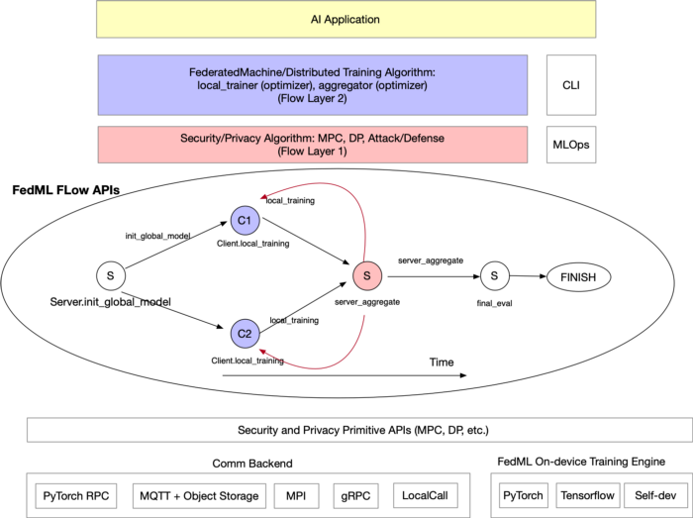
FedML
FedML Product Overview, https://medium.com/@FedML/fedml-ai-platform-releases-the-worlds-federated-learning-open-platform-on-public-cloud-with-an-8024e68a70b6
5. Simple and flexible APIs, boosting innovation in algorithm and system optimization
Specifically, as shown in the figure, FedML regards distributed computing processes such as complex security protocols and distributed training as a directed acyclic graph (DAG) flow computing process, making the writing of complex protocols similar to stand-alone programs.
Based on this idea, the security protocol Flow Layer 1
and the machine learning algorithm process Flow Layer 2
can be easily separated so that security engineers and machine learning engineers can perform their duties without having to master multiple technologies with the same mindset.

Slide 18
Federated Learning
FedML Product Overview, https://medium.com/@FedML/fedml-ai-platform-releases-the-worlds-federated-learning-open-platform-on-public-cloud-with-an-8024e68a70b6
5. Simple and flexible APIs, boosting innovation in algorithm and system optimization
For a more intuitive understanding of FedML Flow, the following example demonstrates the process of implementing the FedAvg algorithm and adding multiple distributed tasks through FedML Flow.
First, each distributed node can be regarded as an abstract FedMLExecutor, which is carried in an independent process and is responsible for executing a specific task. This task can be training or some protocol messages, thus maintaining a high degree of flexibility and abstraction.
Flow is a framework that helps to transfer the behavior of these distributed Executors, and it can arrange the order of task execution and message passing between tasks. Specific to a FedAvg algorithm, we can define a Client Executor and a Server Executor object and use their custom functions as tasks in the flow.
Through the Flow API, users can freely combine the execution processes of these Executors. The following code shows the entire process of model initialization, multiple rounds of training, and finally, distributed evaluation of the model.
The most important thing is that is that this programming example only happens on the personal computer of FedML users and does not require any distributed system development skills

Slide 19
FedML
FedML Product Overview, https://medium.com/@FedML/fedml-ai-platform-releases-the-worlds-federated-learning-open-platform-on-public-cloud-with-an-8024e68a70b6
if args.rank == 0:
executor = Server(args)
executor.init(device, dataset, model)
else:
executor = Client(args)
executor.init(device, dataset, model)
fedml_alg_flow = FedMLAlgorithmFlow(args, executor)
fedml_alg_flow.add_flow("init_global_model", Server.init_global_model)
fedml_alg_flow.add_flow("handle_init", Client.handle_init_global_model)
for round_idx in range(args.comm_round):
fedml_alg_flow.add_flow("local_training", Client.local_training)
fedml_alg_flow.add_flow("server_aggregate", Server.server_aggregate)
fedml_alg_flow.add_flow("final_eval", Server.final_eval)
fedml_alg_flow.build()
fedml_runner = FedMLRunner(args, device, dataset, model, algorithm_flow=fedml_alg_flow)
fedml_runner.run()
class Client(FedMLExecutor):
def local_training(self):
def handle_init_global_model(self):
class Server(FedMLExecutor):
def init_global_model(self):
def server_aggregate(self):
def final_eval(self):

Slide 20
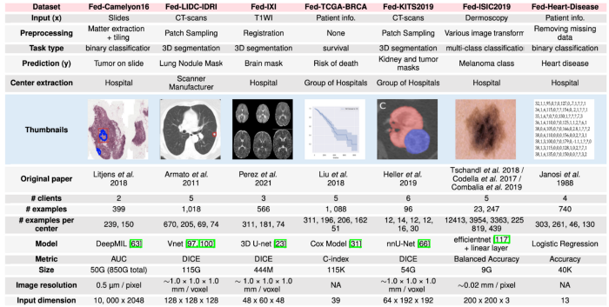
FedML
FedML Product Overview, https://medium.com/@FedML/fedml-ai-platform-releases-the-worlds-federated-learning-open-platform-on-public-cloud-with-an-8024e68a70b6
6. Release Cross-silo FL dataset with Okwin, allowing research face real scenarios
Different from the synthetic or hypothetical data combed by papers such as LEAF and FedScale (note: only natural ID segmentation does not represent the authenticity of products and business scenarios), the datasets released by FedML and Okwin are taken from real federated learning scenarios.
As shown in the figure below, the current version mainly focuses on medical scenarios, containing 7 naturally partitioned medical datasets covering multiple tasks, models, and data modalities, each with baseline training codes for everyone to conduct research and development. All these results are published on the FedML open platform; see https://open.fedml.ai for details (click “App Ecosystem” after logging in).

Slide 21
FedML
FedML Product Overview, https://medium.com/@FedML/fedml-ai-platform-releases-the-worlds-federated-learning-open-platform-on-public-cloud-with-an-8024e68a70b6
7. Published 50+ top scientific papers, covering key challenges such as security, efficiency, weak supervision, and fairness
All papers are summarized at https://doc.fedml.ai/resources/papers.html
8. Academia Sponsorship
For more details, please visit: https://fedml.ai/academia-sponsorship/
9. FedML Team

Slide 22
AIFactory
https://aifactory.space/

Slide 23

디지털 헬스케어 서비스를 위한
연합학습 현황 및 과제
이노피아테크 이광기 (kwangkeelee@gmail.com)

Slide 24
Federated Learning
Federated learning is a machine learning setting where multiple entities (clients) collaborate in solving a machine learning problem, under the coordination of a central server or service provider. Each client’s raw data is stored locally and not exchanged or transferred; instead, focused updates intended for immediate aggregation are used to achieve the learning objective.
Advances and Open Problems in Federated Learning,
https://arxiv.org/abs/1912.04977
연합학습은 중앙 서버 또는 서비스 제공자의 관리 하에, 다수의 클라이언트/디바이스가 기계학습 문제를 해결하기 위해 협력하는 기술
각 클라이언트/디바이스는 보유한/생산한 원시 데이터를 교환 또는 (중앙으로) 전송하지 않고, 로컬모델 학습에만 사용함으로써, 데이터 생산자의 프라이버시 보호
각 클라이언트/디바이스에서의 학습 결과는 (중앙의) 글로벌 모델 학습에 반영/기여. ‘A fed B’학습의 성능은 ‘A+B’성능에 근사
데이터 생산자의 프라이버시 보호, 통신 오버헤드 감소

Slide 25
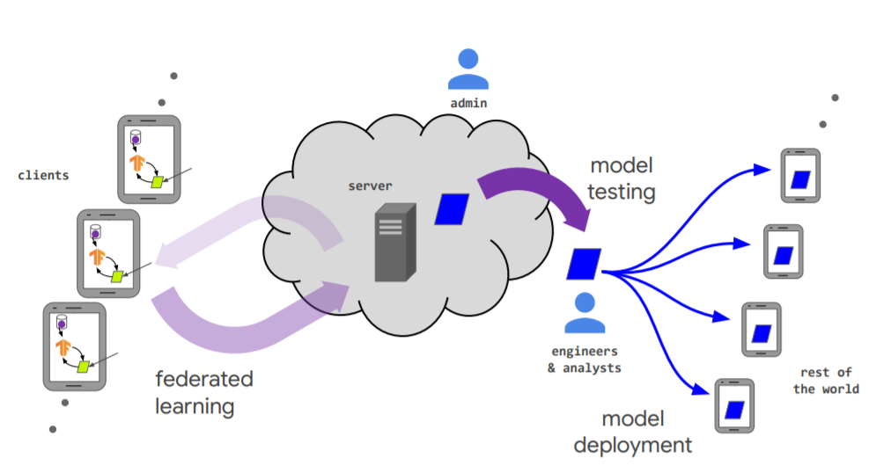
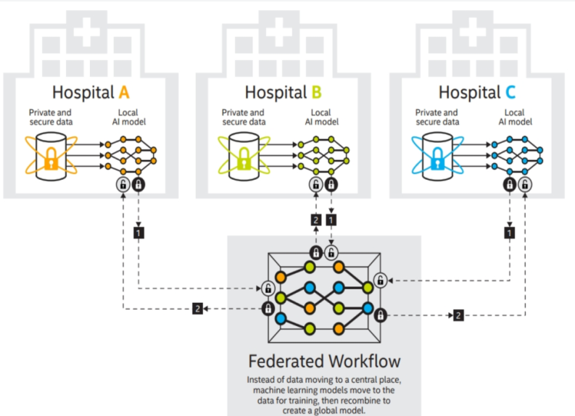
Federated Learning
▶ 개인 정보의 노출/침해 없이, 데이터를 확보/활용할 수 있는 연합학습 기술
인공지능 모델을 학습하기 위해서는 많은 양의 데이터가 필요하지만, 데이터 프라이버시 정책 등으로 인하여 (개인)데이터 수집/활용에 제약
기존에는 중앙 서버에 모든 데이터를 수집 후 학습하는 과정이 일반적으로, 프라이버시 침해 위험이 존재. 이를 개선하기 위해 각 디바이스에서 로컬 모델을 학습하고 이를 동기화하는 연합학습 기술 필요성 대두
연합학습 기술은 사용자 로컬 데이터에 직접 접근하지 않으면서 모든 사용자들의 정보를 반영한 글로벌 모델을 학습하여 이용할 수 있음

Slide 26
연합학습 개요
연합학습은, 로컬 데이터 샘플을 보유하는 다수의 분산 에지 장치 또는 서버들이 원시 데이터를 교환/공유하지 않고 기계학습 문제를 해결하기 위해 협력하는 기술
각 로컬노드(클라이언트/디바이스)는 생산한/보유한 원시 데이터를 로컬모델 학습에만 사용함으로써, 데이터 생산자/제공자의 프라이버시를 보호하고, 데이터 소유/활용의 파편화 문제를 해결
모든 로컬 데이터 세트가 하나의 서버에 업로드/공유 되는 전통적인 중앙집중식 기계학습 방식 혹은 로컬 데이터 샘플이 동일하게 분포 (identically distributed) 된다고 가정하는 전통적인 분산접근 방식과는 대비됨
연합학습은 데이터 소유/관리/활용의 파편화 문제를 해결하기 위한 사일로-교차(Cross-silo) 연합학습, 디바이스/서비스 사용자 데이터를 활용하기 위한 디바이스-교차(Cross-device) 연합학습으로 특징과 이슈를 구분
 | 분산학습 (Datacenter distributed learning) | 사일로-교차 연합학습 (Cross-silo federated learning) | 디바이스-교차 연합학습 (Cross-device federated learning)
환경 | 단일 크러스터 혹은 데이터센터가 대규모 데이터로 학습 | 서로 다른 기관(의료 혹은 금융) 혹은 지리적으로 분산되어 있는 데이터센터들이, 각자의 사일로 데이터를 학습 | 클라이언트는 많은 수의 모바일 혹은 IoT 디바이스
데이터 분산 | 데이터는 중앙에 저장되며, 클라이언트들은 데이터에 제한 없이 접근, 혼합 | 데이터는 로컬에서 생성, 분산되어 있음. 각 클라이언트는 자신의 데이터를 저장하며 다른 클라이언트의 데이터를 읽을 수 없음. 데이터는 iid (independently or identically distributed) 하지 않음
오케스트레이션 | 중앙에서 데이터 관리와 학습을 관장 | 중앙 오케스트레이션 서버/서비스 주도로 학습을 관장하지만, 원시 데이터에는 접근하지 않음
데이터 가용성 | 모든 클라이언트가 항상 가용 |  | 일정 시간에, 일부 클라이언트만 가용
분산 규모 | 1 - 1000 클라이언트 | 2 - 100 클라이언트 | 10¹⁰ 까지 대규모
주요 병목 | Computation (연산량 및 연산속도) | 연산 및 통신 | 일반적으로 통신이 주된 병목
Advances and Open Problems in Federated Learning, https://arxiv.org/abs/1912.04977
Notes:
연합학습은, 다수의 분산 에지장치 또는 서버들이 원시 데이터를 교환하지 않고 로컬모델 학습에만 사용함으로써, ♥♥♥ 데이터 제공자의 프라이버시를 보호하고, 데이터 소유와 활용의 파편화 문제를 해결할 수 있습니다. ♥♥♥ 연합학습은 사일로-교차 연합학습 과 디바이스-교차 연합학습으로 그 특징과 이슈를 구분할 수 있습니다만, ♥♥♥ 본 과제에서는 많은 수의 모바일 혹은 IoT 디바이스가 학습에 참여하는 디바이스-교차 연합학습을 대상으로 개발 목표를 설정하였습니다.

Slide 27
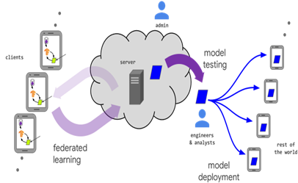
연합학습 개요 : Cross-silo vs. Cross-device
사일로-교차 연합학습 (Cross-silo FL) :
서로 다른 기관 (의료 혹은 금융) 혹은 지리적으로 분산되어 있는 데이터센터들이, 각자의 사일로 데이터를 학습 : 2 - 100 clients
데이터/통계적 이질성, 디바이스/시스템적 이질성 문제 小
모든 클라이언트가 항상 가용
디바이스-교차 연합학습 (Cross-device FL) :
사용자의 개인 디바이스 (휴대폰, IoT) 가 개인 데이터를 학습 : Massive # of clients
데이터/통계적 이질성, 디바이스/시스템적 이질성 문제 大
일정 시간에 일부 클라이언트만 가용하고, straggler effect 대응 필요
* 통계적 이질성: 다수의 다양한 사용자/디바이스, 동적 환경 및 시공간으로부터 수집된 데이터는 독립동일분포(iid: independent identically distributed) 조건을 만족하지 못하고 비균일/불균형의 특성을 지님
** 시스템적 이질성: 연합학습에 참여/기여하는 디바이스의 성능과 기능 및 네트워크 환경이 다양하고, 디바이스의 추가, 변동이 지속적으로 발생
인공지능 기술청사진 2030 2차년도 보고서,
https://www.iitp.kr/kr/1/knowledge/openReference/view.it?ArticleIdx=5248&count=true
Notes:
수개 많아야 수십 개의 데이터 센터들이 학습에 참여하는 사일로-교차 연합학습과 달리, ♥♥♥ 디바이스-교차 연합학습은 수십만, 수백만개 이상의 디바이스 들이 학습에 참여하는 시니리오로써, ♥♥♥ 데이터의 통계적 이질성과 디바이스의 시스템적 이질성이라는 근원적인 문제를 내포하고 있습니다.

Slide 28
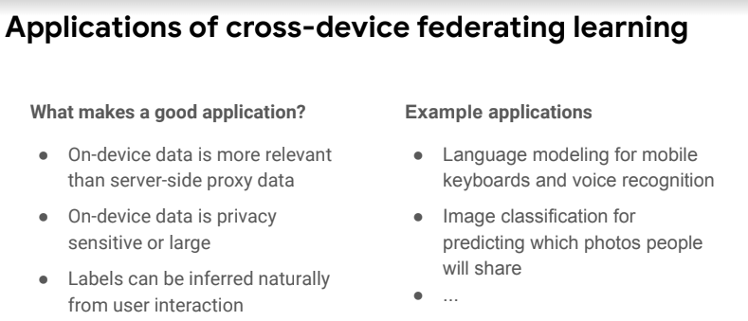
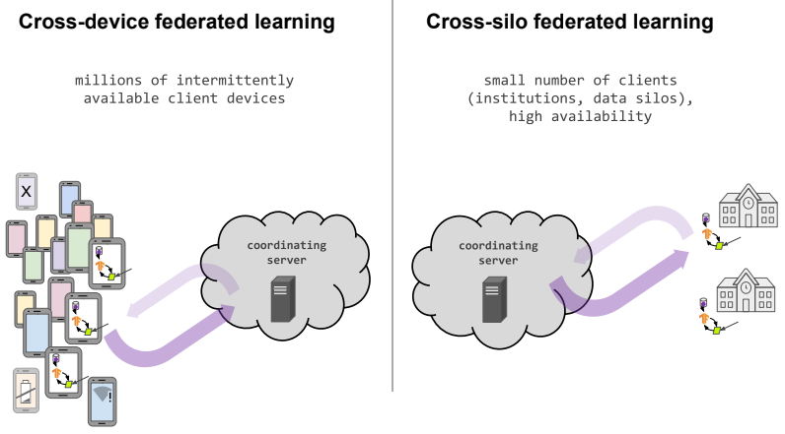
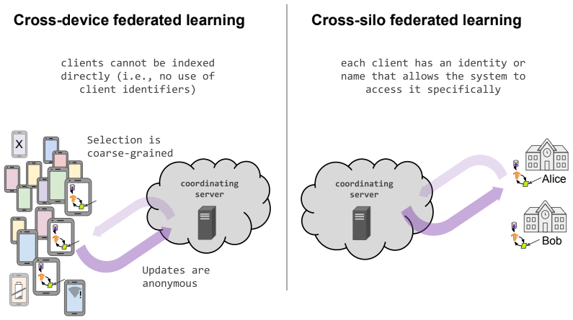
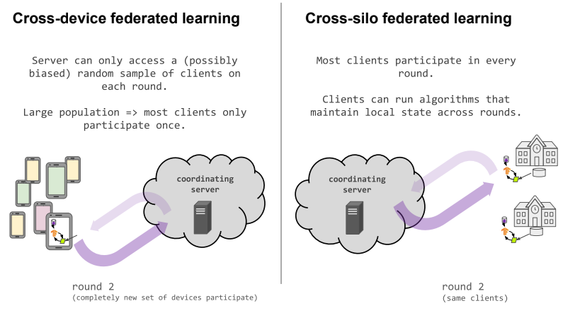
연합학습 개요
Federated Learning Tutorial@NeurIPS 2020, https://sites.google.com/view/fl-tutorial/

Slide 29
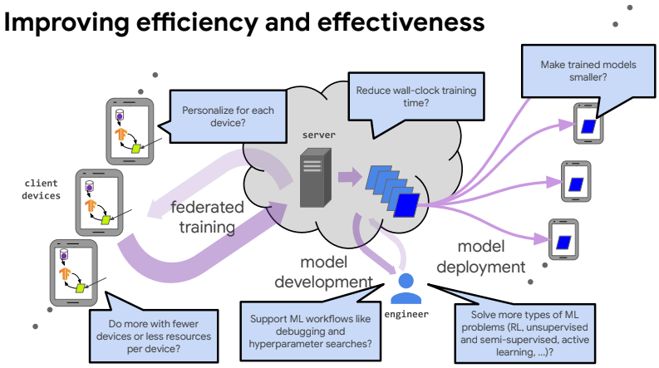
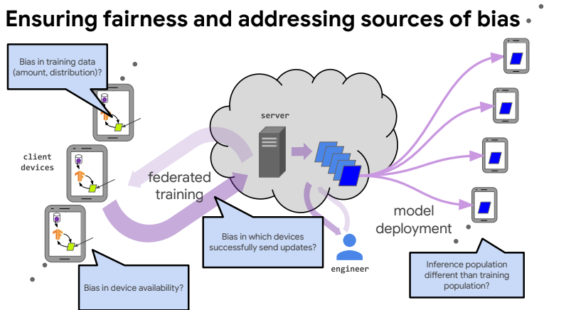
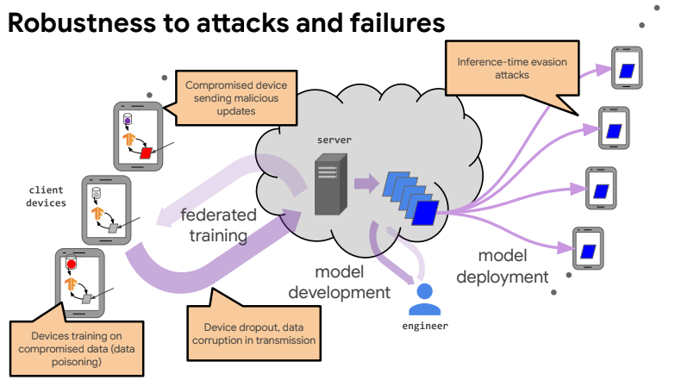
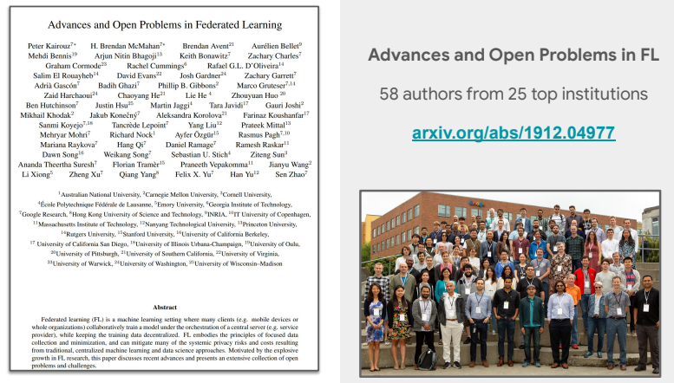
연합학습 개요
Federated Learning Tutorial@NeurIPS 2020, https://sites.google.com/view/fl-tutorial/
Notes:
수개 많아야 수십 개의 데이터 센터들이 학습에 참여하는 사일로-교차 연합학습과 달리, ♥♥♥ 디바이스-교차 연합학습은 수십만, 수백만개 이상의 디바이스 들이 학습에 참여하는 시니리오로써, ♥♥♥ 데이터의 통계적 이질성과 디바이스의 시스템적 이질성이라는 근원적인 문제를 내포하고 있습니다.

Slide 30
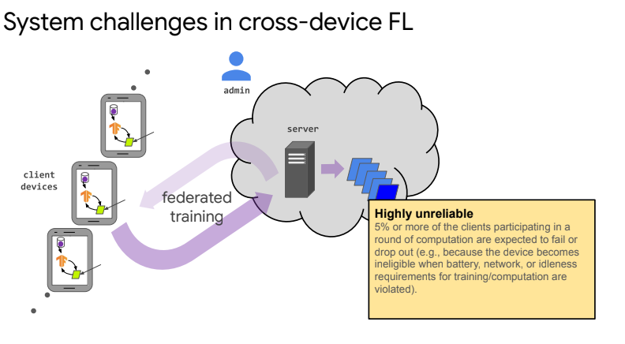
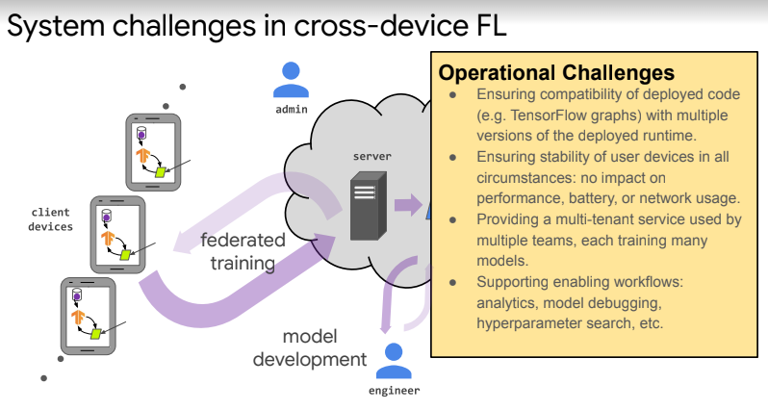
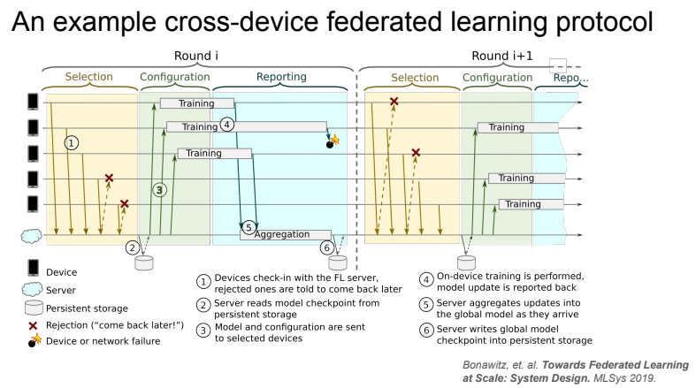
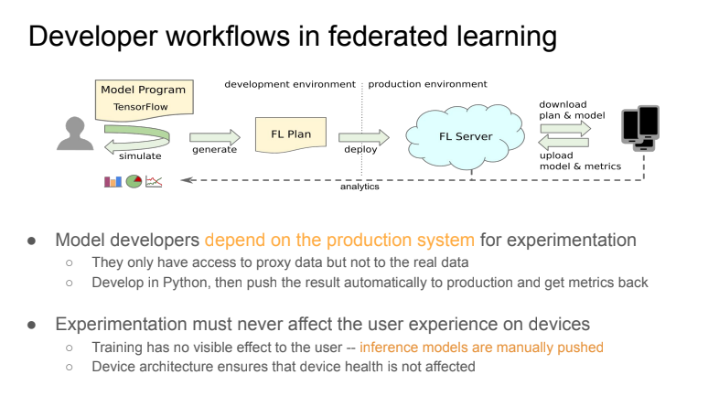
연합학습 개요
Federated Learning Tutorial@NeurIPS 2020, https://sites.google.com/view/fl-tutorial/
Notes:
수개 많아야 수십 개의 데이터 센터들이 학습에 참여하는 사일로-교차 연합학습과 달리, ♥♥♥ 디바이스-교차 연합학습은 수십만, 수백만개 이상의 디바이스 들이 학습에 참여하는 시니리오로써, ♥♥♥ 데이터의 통계적 이질성과 디바이스의 시스템적 이질성이라는 근원적인 문제를 내포하고 있습니다.

Slide 31
Open FL Platforms
Open FL Platform (Active) | Affiliation
Flower: A Friendly Federated Learning Framework, https://flower.dev/ | U of Cambridge, Samsung
FedScale: A scalable and extensible federated learning engine and benchmark, http://fedscale.ai/ | U of Michigan
FedML: https://fedml.ai/ | USC & FedML Inc.
FLSim: https://github.com/facebookresearch/FLSim | Meta/Facebook Research
Open FL Platform (Etc) | Affiliation
TensorFlow Federated (TFF), https://www.tensorflow.org/federated?hl=ko | Google
PySyft, https://github.com/OpenMined/PySyft | OpenMined
FedAI, https://www.fedai.org/ | WeBank
Open Federated Learning (OpenFL) - An Open-Source Framework For Federated Learning, https://github.com/intel/openfl | Intel
IBM Federated Learning, https://ibmfl.mybluemix.net/ | IBM Research.
OpenFed, https://github.com/FederalLab/OpenFed | --
FL_PyTorch, https://github.com/burlachenkok/flpytorch | --
Notes:
우선, [T1] 개인화지원 연합학습의 기반기술로 활용될 MetaSense 에 대해 소개드리겠습니다. ♥♥♥ MetaSense 는 공동연구기관인 KAIST 이성주 교수 연구실의 대표적인 연구실적으로, MAML 즉 Model-Agnostic Meta-Learning 을 기반으로 사용자 및 디바이스의 특징을 반영하기 위한 적응적 학습기술입니다. ♥♥♥ MAML과 MetaSense의 차이점은 메타러닝의 학습단위인 task 의 결정 방법에 있습니다. 그림의 빨간색 box 에 해당하는 부분입니다. ♥♥♥ 전통적인 MAML에서는 모델이 활용되는 domain 의 특성을 고려하지 않고 task를 random generation하는 반면, ♥♥♥ MetaSense 에서는 모바일 환경에서의 특성, ♥♥♥ 즉 user 간 상이한 센싱 환경, 데이터의 부족, classification space의 일관성을 고려한 세가지 task generation 전략을 활용하게 됩니다.

Slide 32
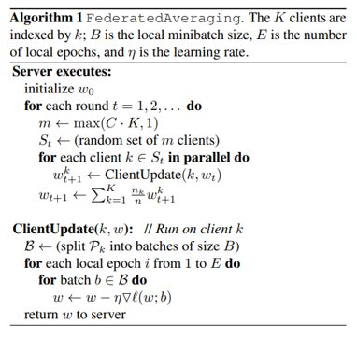
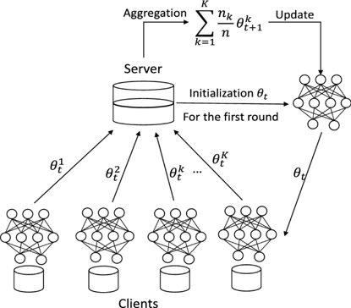
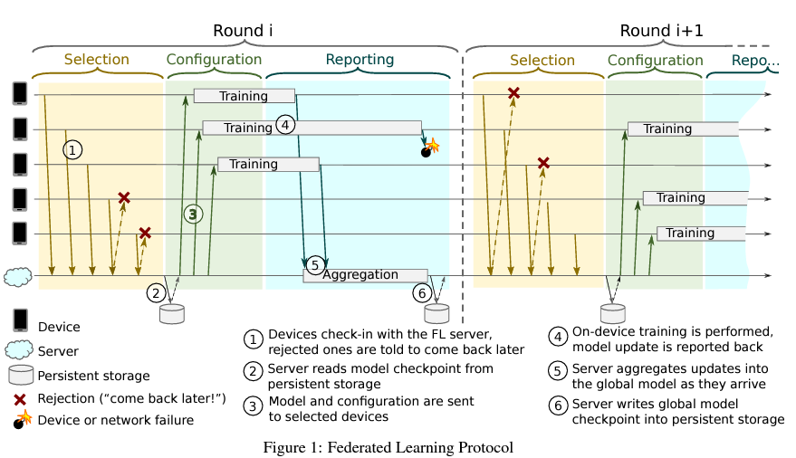
Vanilla Federated Learning

Slide 33
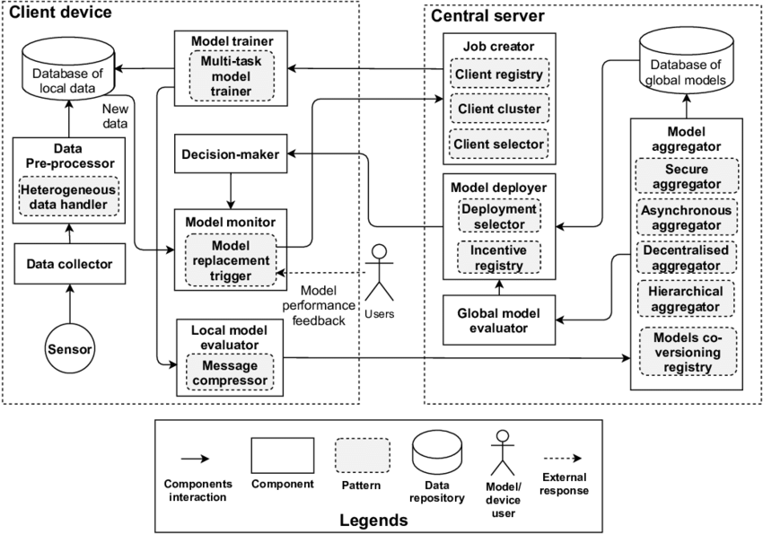
FLRA: A Reference Architecture for Federated Learning Systems
FLRA: A Reference Architecture for Federated Learning Systems, https://arxiv.org/abs/2106.11570
Notes:
우선, [T1] 개인화지원 연합학습의 기반기술로 활용될 MetaSense 에 대해 소개드리겠습니다. ♥♥♥ MetaSense 는 공동연구기관인 KAIST 이성주 교수 연구실의 대표적인 연구실적으로, MAML 즉 Model-Agnostic Meta-Learning 을 기반으로 사용자 및 디바이스의 특징을 반영하기 위한 적응적 학습기술입니다. ♥♥♥ MAML과 MetaSense의 차이점은 메타러닝의 학습단위인 task 의 결정 방법에 있습니다. 그림의 빨간색 box 에 해당하는 부분입니다. ♥♥♥ 전통적인 MAML에서는 모델이 활용되는 domain 의 특성을 고려하지 않고 task를 random generation하는 반면, ♥♥♥ MetaSense 에서는 모바일 환경에서의 특성, ♥♥♥ 즉 user 간 상이한 센싱 환경, 데이터의 부족, classification space의 일관성을 고려한 세가지 task generation 전략을 활용하게 됩니다.

Slide 34
Personalization for FL
*** 연합학습은 일반적으로 모든 디바이스 및 사용자에 공통으로 적용되는 글로벌모델을 학습하는 것을 목표로 하고 있으나, 동적인 디바이스 환경의 데이터 이질성 및 디바이스 이질성으로 인하여 모든 디바이스에서 잘 동작하는 하나의 모델을 학습하기 어려우며, 개별 디바이스 및 사용자 관점에서 최적의 성능이 보장되지 않음. 동적인 디바이스 환경에서 각 사용자 및 디바이스의 특징과 애플리케이션 요구사항을 최적 반영하기 위해서는, 글로벌 모델 뿐 만 아니라 개인화·로컬 모델(locally adapted personalized model)의 성능을 최적화할 수 있는 연합학습 기술 필요
Personalization 방식 | 특징
Adding User Context | user clustering where similar clients are grouped together and a separate model is trained for each group.
Transfer Learning | some or all parameters of a trained global model are re-learned on local data. To avoid the problem of catastrophic forgetting [21] [22], care must be taken to not retrain the model for too long on local data. A variant technique freezes the base layers of the global model and retrains only the top layers on local data. Transfer learning is also known as fine-tuning, and it integrates well into the typical federated learning lifecycle.
Multi-task Learning | multiple related tasks are solved simultaneously allowing the model to exploit commonalities and differences across the tasks by learning them jointly
Meta-Learning | MAML builds an internal representation generally suitable for multiple tasks, so that fine tuning the top layers for a new task can produce good results. MAML proceeds in two connected stages: meta-training and meta-testing. Meta-training builds the global model on multiple tasks, and meta-testing adapts the global model individually for separate tasks.
Knowledge Distillation | extracting the knowledge of a large teacher network into a smaller student network by having the student mimic the teacher.
Base + Personalization Layers | the base layers are trained centrally by Federated Averaging, and the top layers (also called personalization layers) are trained locally with a variant of gradient descent
Mixture of Global and Local Models | Instead of learning a single global model, each device learns a mixture of the global model and its own local model.
Survey of Personalization Techniques for Federated Learning, https://arxiv.org/abs/2003.08673
Notes:
본 과제에서 도전하고자 하는 첫번째 핵심주제는 학습모델의 개인화를 지원하는 적응적 연합학습 입니다. ♥♥♥ 여기서 개인화는 local 디바이스 혹은 사용자에게 최적화된 모델로 이해할 수 있으며 ♥♥♥ 본 과제에서는 메타러닝에 기반하여 개인화를 지원하는 기술을 개발하겠습니다. ♥♥♥ 동적인 디바이스 환경에서의 연합학습은, 통계적 이질성과 시스텀적 이질성으로 인하여 모든 디바이스에서 잘 동작하는 하나의 모델을 학습하기 어려우며, 최적의 성능이 보장되지도 않습니다. ♥♥♥ 결국, 사용자 및 디바이스의 특징과 애플리케이션 요구사항을 최적 반영하기 위해서는, 글로벌모델 뿐만 아니라 로컬모델의 성능을 최적화할 수 있는 연합학습기술이 필요하게 됩니다.

Slide 35
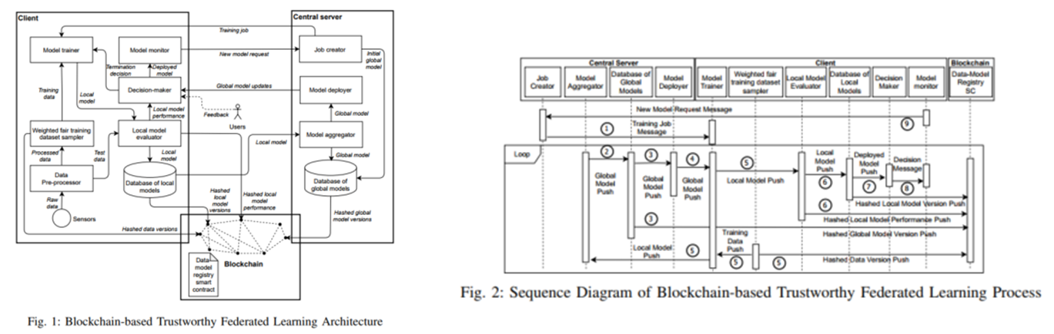
Blockchain-based trustworthy federated learning architecture
Towards Trustworthy AI: Blockchain-based Architecture Design for Accountability and Fairness of Federated Learning Systems, https://ieeexplore.ieee.org/abstract/document/9686048
https://github.com/Kwangkee/FL/blob/main/FL%40CSIRO.md#towards-trustworthy-ai
However, federated learning systems struggle to achieve and embody responsible AI principles. In particular, federated learning systems face accountability and fairness challenges due to multi-stakeholder involvement and heterogeneity in client data distribution. To enhance the accountability and fairness of federated learning systems, we present a blockchain-based trustworthy federated learning architecture.
We designed the architecture based on a reference architecture for federated learning system named FLRA [6]. https://arxiv.org/abs/2106.11570
Notes:
우선, [T1] 개인화지원 연합학습의 기반기술로 활용될 MetaSense 에 대해 소개드리겠습니다. ♥♥♥ MetaSense 는 공동연구기관인 KAIST 이성주 교수 연구실의 대표적인 연구실적으로, MAML 즉 Model-Agnostic Meta-Learning 을 기반으로 사용자 및 디바이스의 특징을 반영하기 위한 적응적 학습기술입니다. ♥♥♥ MAML과 MetaSense의 차이점은 메타러닝의 학습단위인 task 의 결정 방법에 있습니다. 그림의 빨간색 box 에 해당하는 부분입니다. ♥♥♥ 전통적인 MAML에서는 모델이 활용되는 domain 의 특성을 고려하지 않고 task를 random generation하는 반면, ♥♥♥ MetaSense 에서는 모바일 환경에서의 특성, ♥♥♥ 즉 user 간 상이한 센싱 환경, 데이터의 부족, classification space의 일관성을 고려한 세가지 task generation 전략을 활용하게 됩니다.

Slide 36
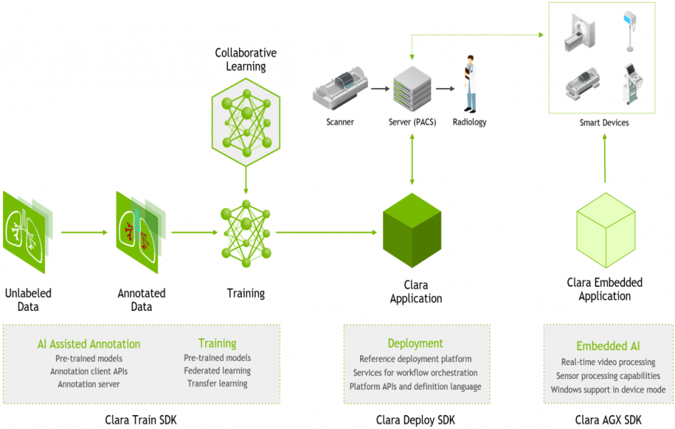
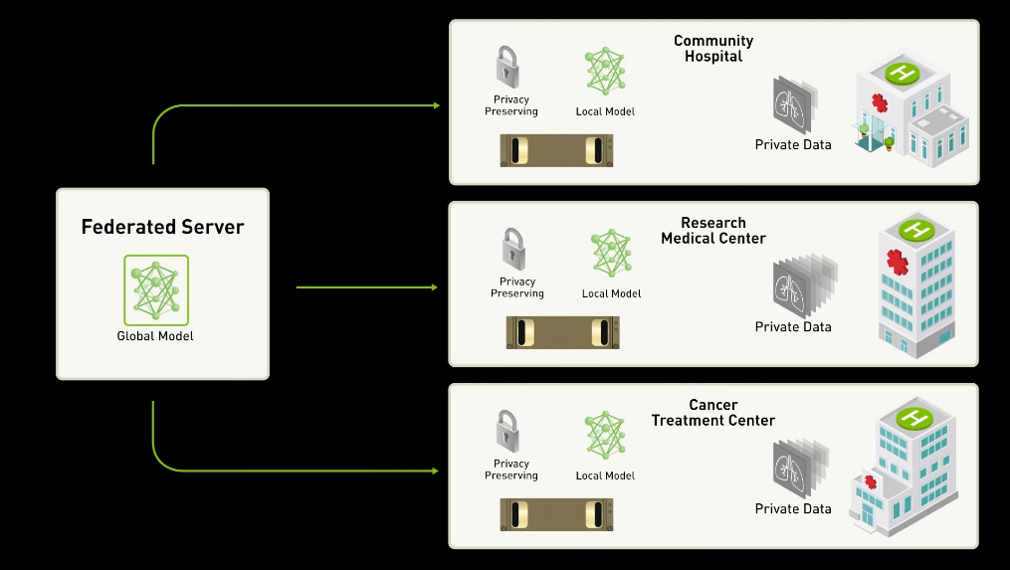
Federated Learning powered by NVIDIA Clara
An Application Framework Optimized for Healthcare and Life Sciences Developers, https://developer.nvidia.com/clara
Federated Learning powered by NVIDIA Clara, https://developer.nvidia.com/blog/federated-learning-clara/
Transforming AI Healthcare with Federated Learning, https://news.developer.nvidia.com/transforming-ai-healthcare-with-federated-learning/
https://www.nature.com/articles/s41746-020-00323-1

Slide 37
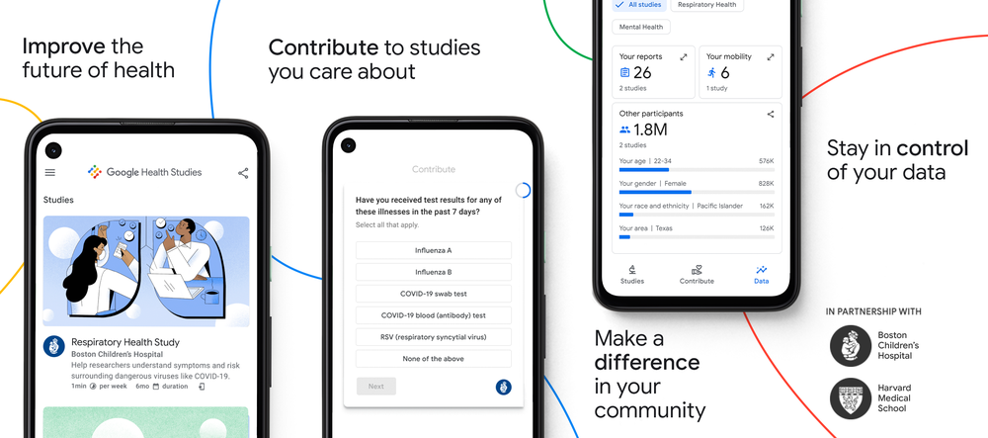
Google Health Studies : 연합학습 적용
Blog: https://blog.google/technology/health/google-health-studies-app/
App: https://play.google.com/store/apps/details?id=com.google.android.apps.health.research.studies
The Google Health Studies app is now available in the Google Play Store, and we’re inviting people to download the app to join this initial study. We look forward to partnering with health researchers and to making it possible for more people to participate in these important studies.
… this first study utilizes federated learning and analytics—a privacy technology that keeps a person’s data stored on the device, while allowing researchers to discover aggregate insights based on encrypted, combined updates from many devices. This means researchers in this study can examine trends to understand the link between mobility (such as the number of daily trips a person makes outside the home) and the spread of COVID-19, This same approach powers typing predictions on Gboard, without Google seeing what individuals type.
Notes:
또한 Google 은 작년 12월 ♥♥♥ Federated Learning 즉 연합학습 기술과 Smartphone App 을 결합하여 ♥♥♥ 사용자가 자신의 증세와 데이터를 자가 모니터링하여, 의료 및 헬스 연구에 자발적으로 기여하게 하는 ♥♥♥ Google Health Studies 를 소개한 바 있습니다.

Slide 38

Google Health Studies : 연합학습 적용
Blog: https://blog.google/technology/health/google-health-studies-app/
App: https://play.google.com/store/apps/details?id=com.google.android.apps.health.research.studies
Google Health Studies lets you securely contribute to health research studies with leading institutions, right from your phone. Volunteer for studies that matter to you and represent your community. Simply download the app and enroll in a study.
Help researchers make advancements in medicine and healthcare:
Self-report symptoms and other data
Volunteer for multiple studies in one app
Track your information with digital health reports
Learn research findings from the studies you participate in
Help scientists better understand respiratory diseases. The first study available is a respiratory health study conducted by Boston Children’s Hospital and Harvard Medical School. If you participate in this study, you’ll provide data to help researchers understand how demographics, health history, behavior, and mobility patterns contribute to the spread of respiratory illnesses. Upcoming studies will research mental health and diabetes. You’re in control of your data: In the respiratory health study, your personal information is kept on your device. Researchers only see aggregated study data combined from all participants. This allows researchers to collect the information needed to advance the study without seeing individual details. Your input matters: Google Health Studies aims to create opportunities for more people to participate in health research. By contributing, you’ll represent your community and start improving the future of health for everyone.
Notes:
현재 유명병원 및 의과대학과 함께 호흡기 질병에 대한 연구를 시작하였으며 ♥♥♥ mental health, 당뇨병 등으로 적용 대상을 넓여갈 계획임을 밝힌 바 있습니다.

